Slide 1
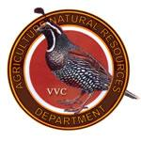

Victor Valley College Agriculture and Natural Resources Department
AGNR
An Environmentally Conscious Department

Slide 2
Agriculture and Natural Ressources Department Degrees
Agriculture-Plant Science, Associate of Science Transfer (AST) Degree
  - A transfer degree in Plant Science to transfer smoothly to a CSU/UC
Agriculture- Animal Science, Associate of Science Transfer (AST) Degree
  - A transfer degree in Animal Science to transfer smoothly to a CSU/UC
Environmental Horticulture Associates of Science (AS) Degree
  - A degree in Environmental Horticulture with the potential to acquire many career technical Certificates under your belt.

Slide 3
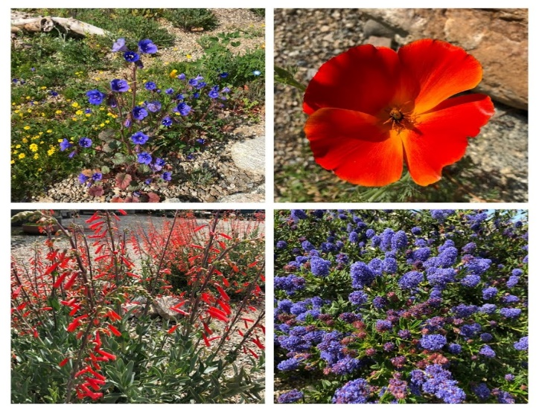
AST Plant Science & AS Environmental Horticulture Certificates
Plant Science Certificate of Achievement
Environmental Horticulture and Landscaping Certificate
Ecological Restoration Certificate of Achievement
Natural Resources and Environmental Technology Certificate of Achievement

Slide 4
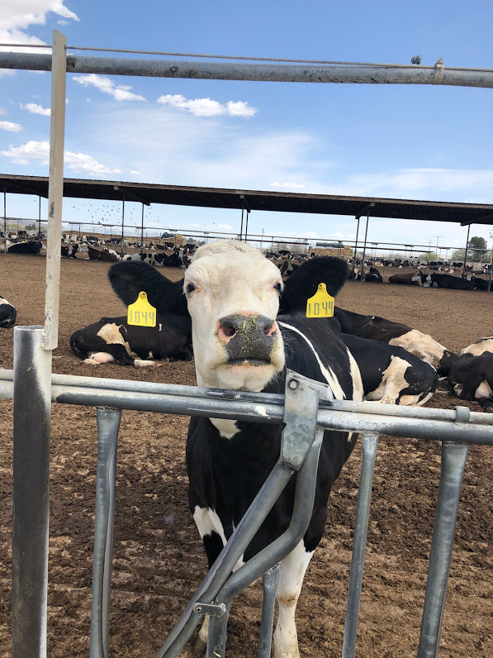
AST Animal Science Certificates
Animal Science Specialist Certificate of Achievement
Equine Science Specialist Certificate of Achievement

Slide 5
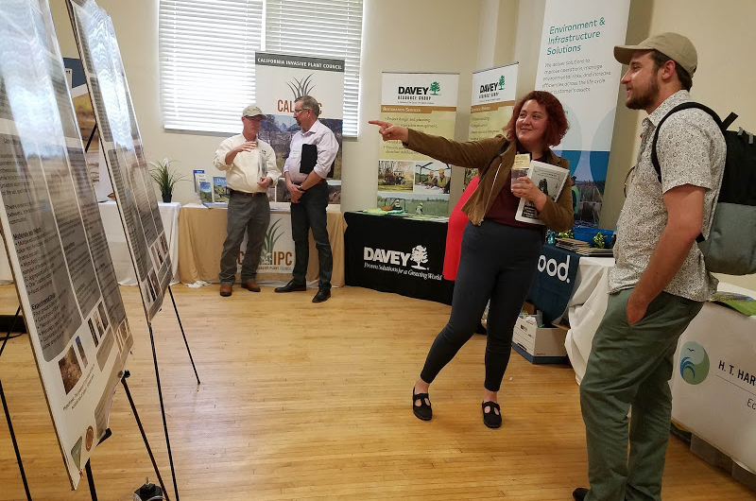
Plant Conservation
The AGNR department strives for plant conservation. In multiple of our classes you will find a plant conservation theme throughout. We have internship opportunities at the department working with government agencies that will give you the experience you need.
AGNR 74D Ecological Restoration
AGNR 122 Plant Propagation
AGNR 123 Plant Science
AGNR 131 Soil Science
AGNR 140 Plant Materials and Usage I (Plant ID)
AGNR 141 Plant Materials and Usage II (Ca. Native Plant ID)

Slide 6
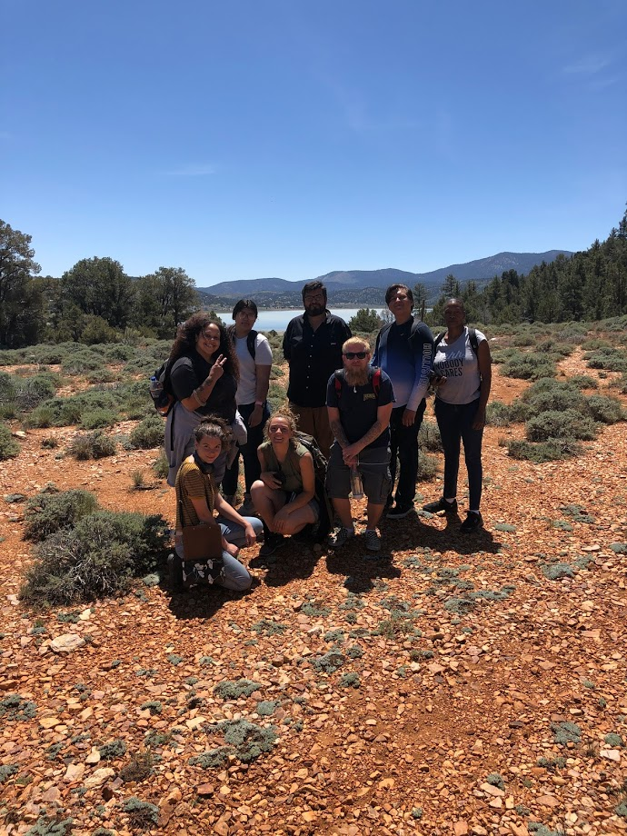
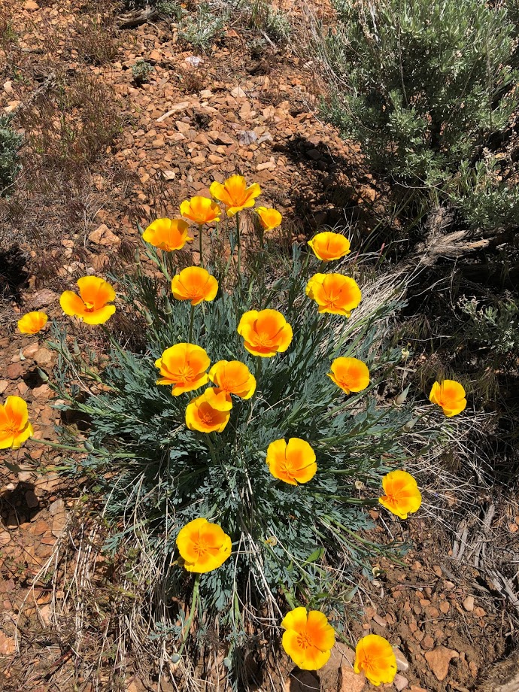

Slide 7
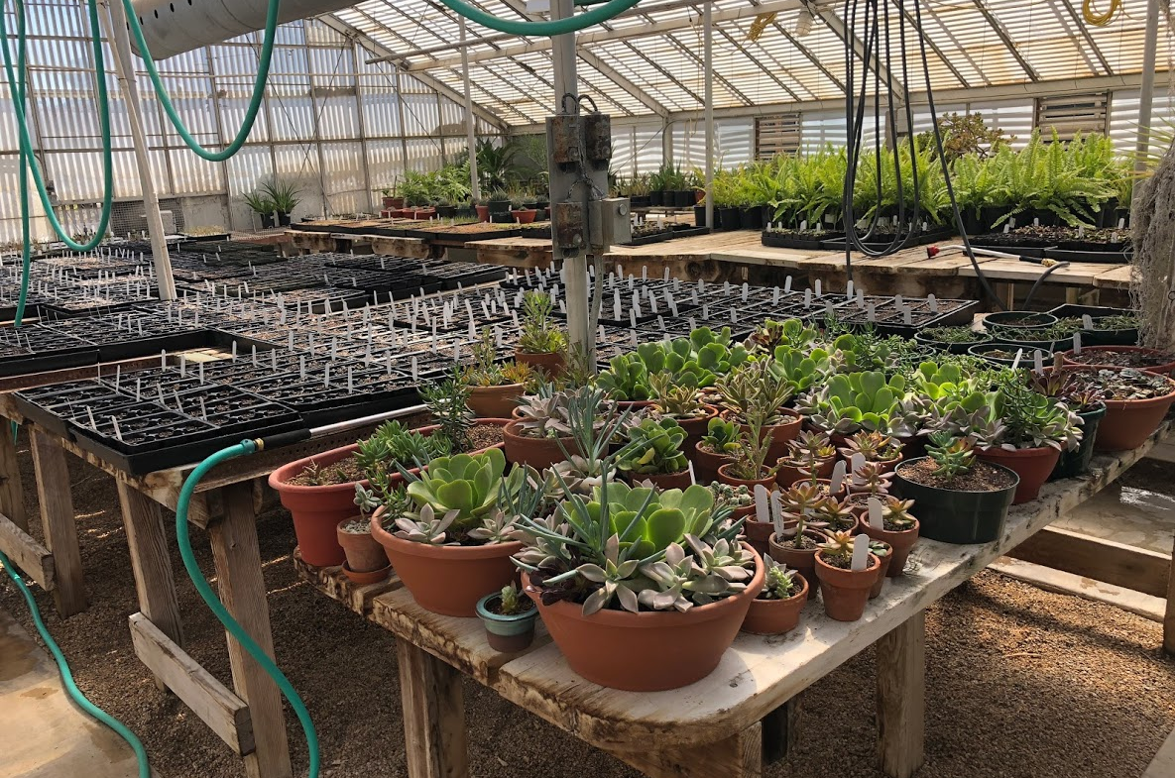
Horticulture
The AGNR department has great classes that offer great hands on learning .
AGNR 120 Integrated Pest Management
AGNR 121 Intro to Environmental Horticulture
AGNR 122 Plant Propagation
AGNR 140 Plant Materials and Usage I (Plant ID)
AGNR 141 Plant Materials and Usage II (Ca. Native Plant ID)
AGNR 150 Landscape Design
AGNR 152 Irrigation Design and Management
AGNR 153 Natural Landscape Maintenance

Slide 8
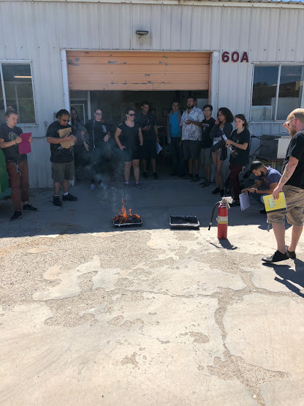
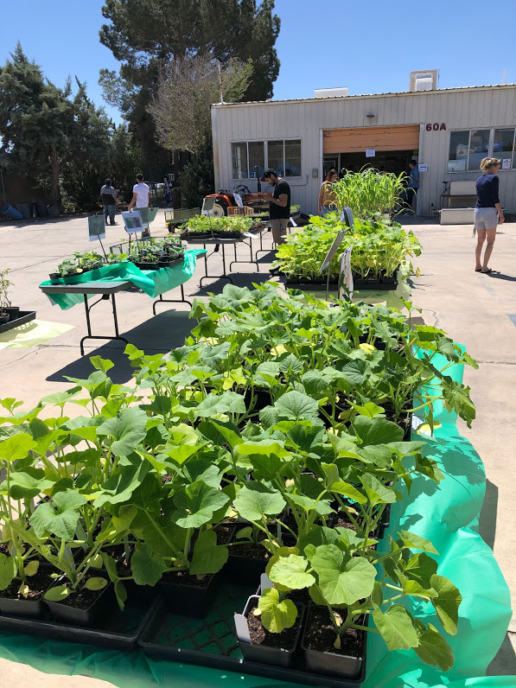

Slide 9
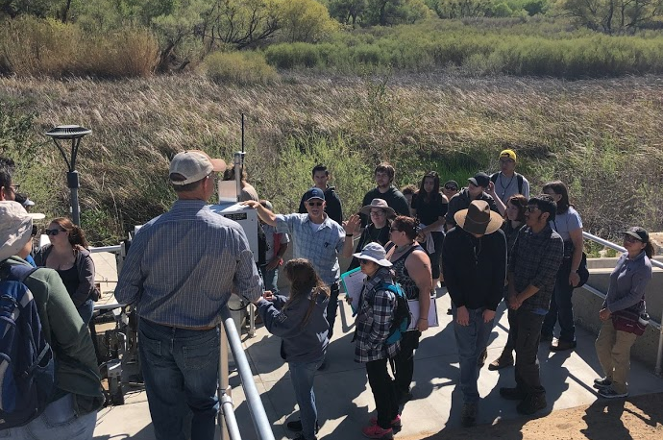
Natural Resources and Sustainability
Our department focuses on Natural Resources here in our Mojave Desert. We work with the community organizations that help conserve and monitor these natural Resources
AGNR 170 Environmental Science and Sustainability
AGNR 172 Geospatial Technology (GIS)
AGNR 173 Watershed Management and Restoration
AGNR 175 Sustainable Agriculture
AGNR 177 Principles of Wildlife Management
AGNR 178 Agriculture Economics

Slide 10
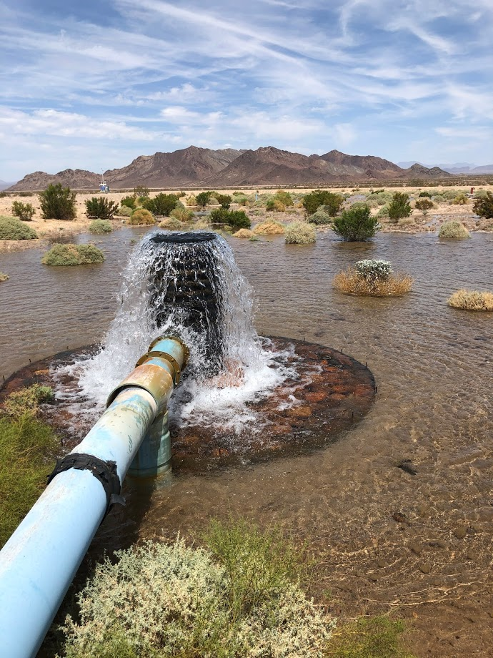
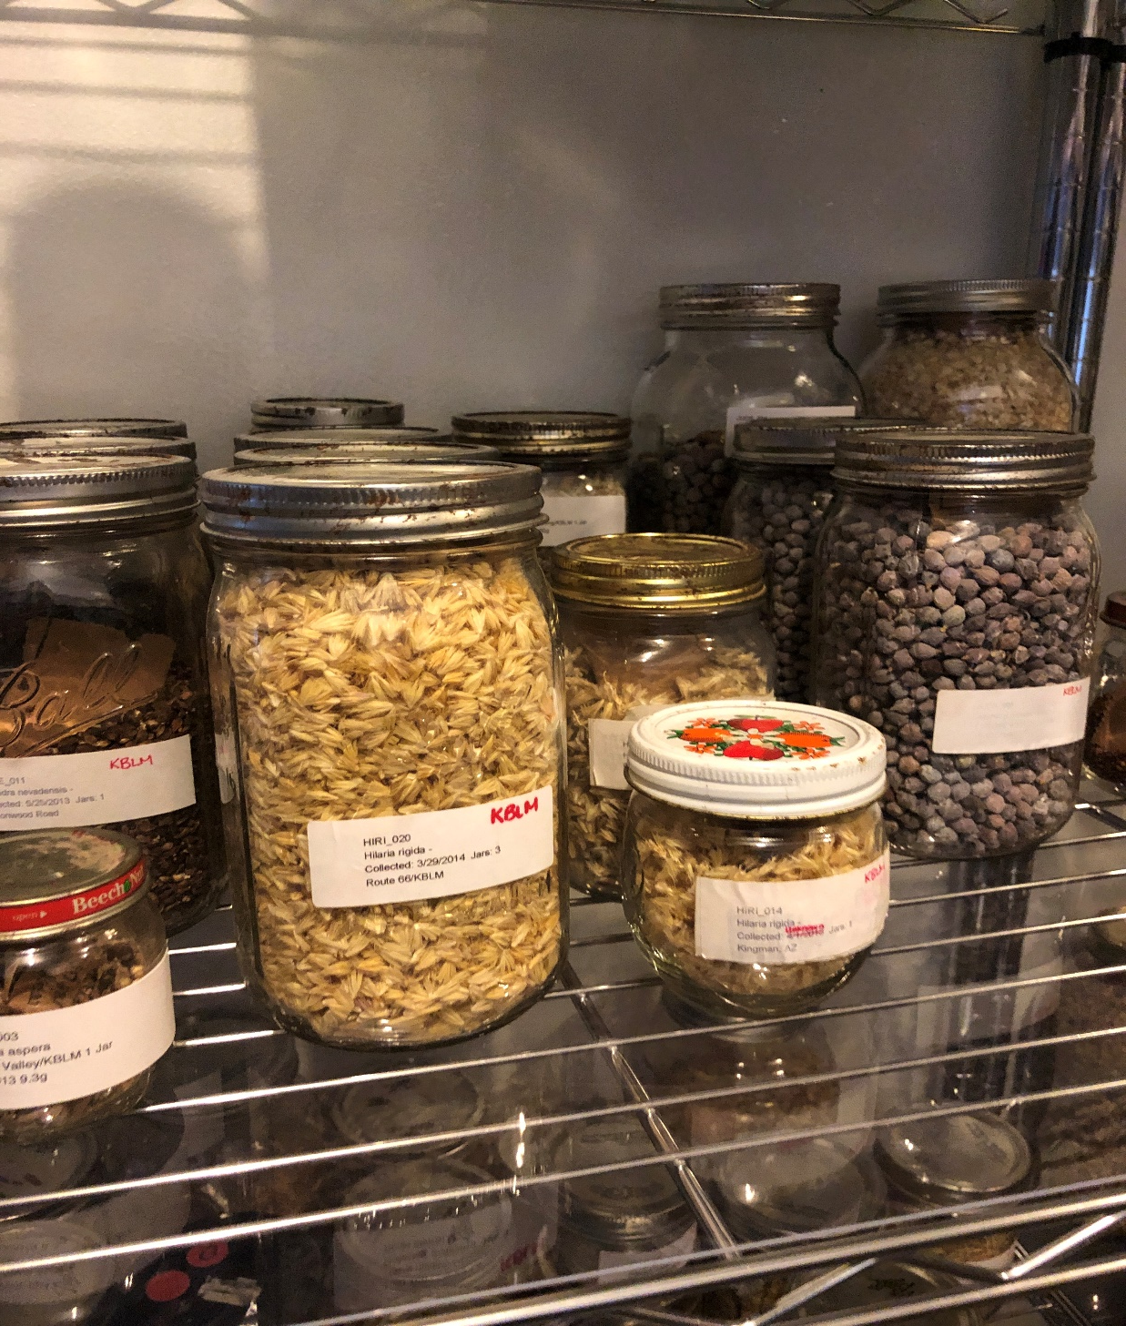

Slide 11
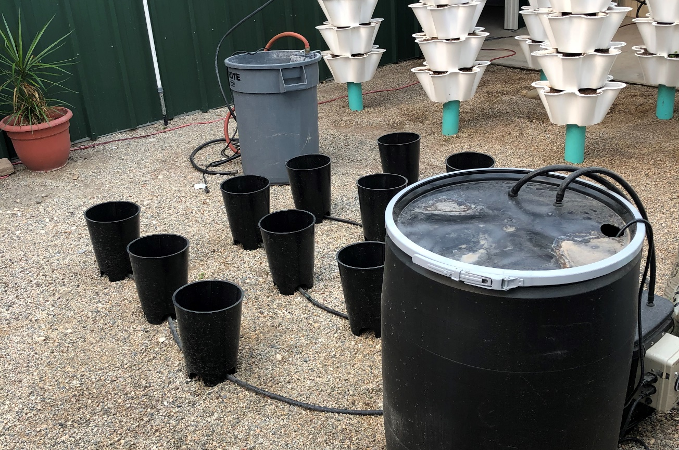
Aquaponics and Hydroponics
Discover our Hydroponic and Aquaponics systems. Learn how to operate and maintain Ebb and flow and Aquaponics systems.
AGNR 60 Environmental Horticulture Lab
AGNR 121 Intro Environmental Horticulture
AGNR 122 Plant Propagation
AGNR 123 Plant Science
AGNR 170 Environmental Science and Sustainability
AGNR 175 Sustainable Ag. Environment and Society

Slide 12
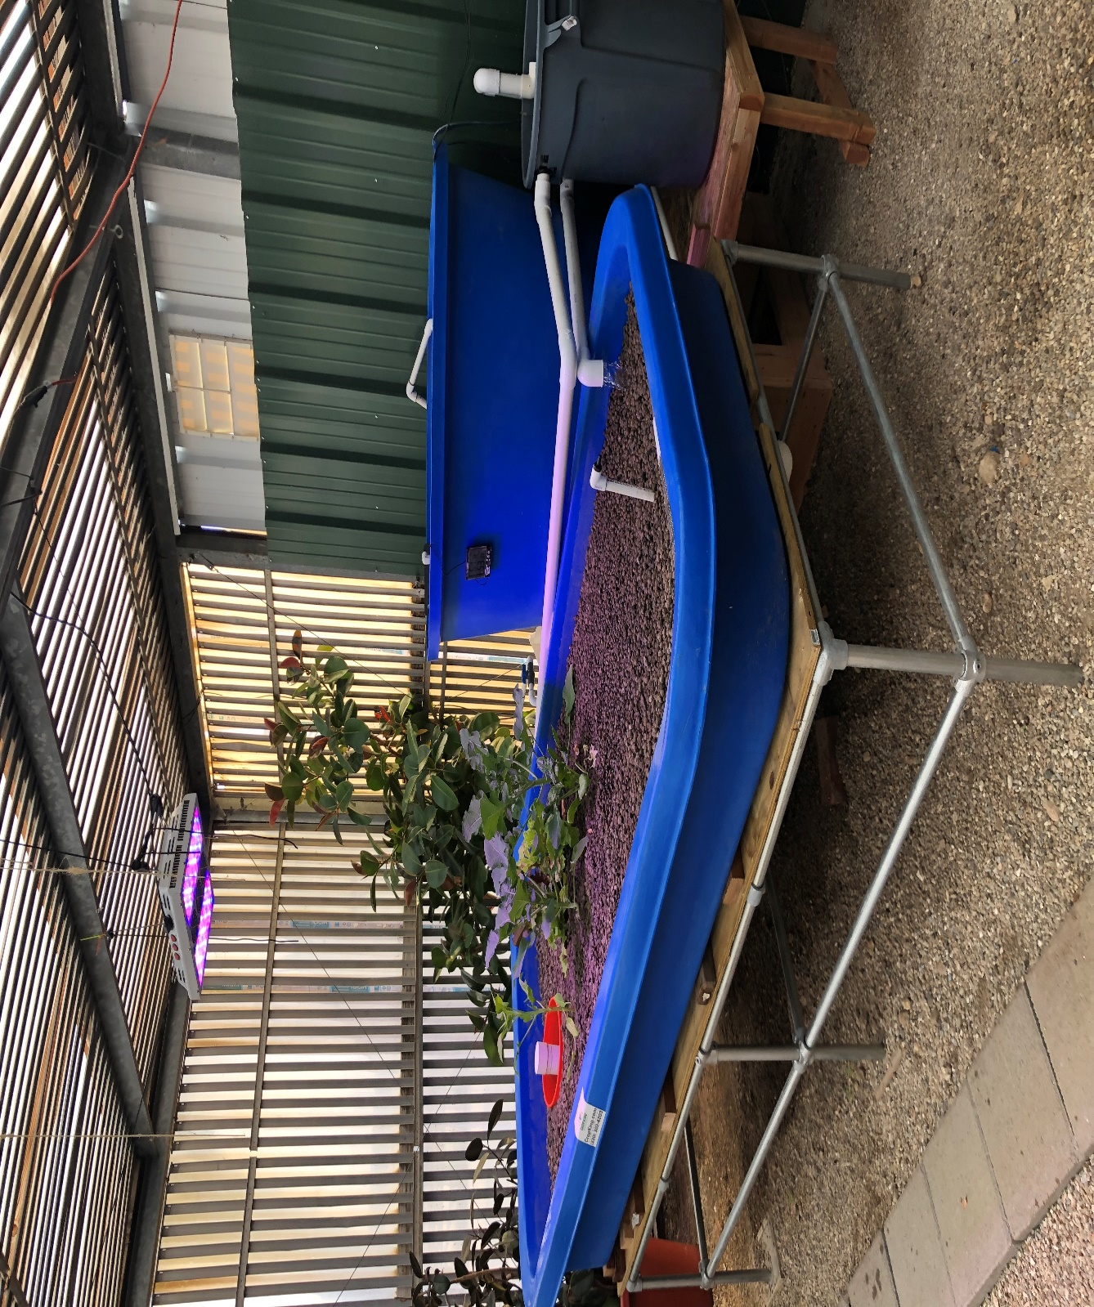

Slide 13
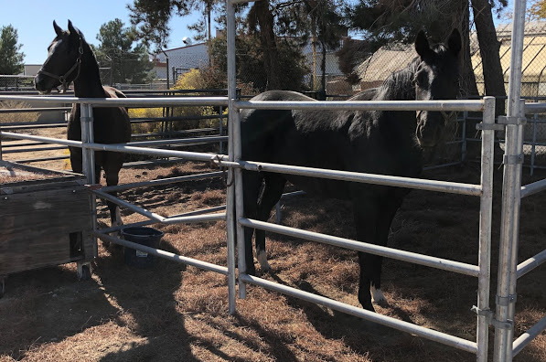
Animal Science
Learn about animal nutrition, Equine Science and Veterinary Services
AGNR 100 General Animal Science
AGNR 101L Livestock Feeding and Nutrition
AGNR 102 Equine Science
AGNR 105 Equine Health
AGNR 106 Veterinary Terminology and Technology
AGNR 107 Livestock Selection and Evaluation
AGNR 108 Animal Health and Sanitation

Slide 14
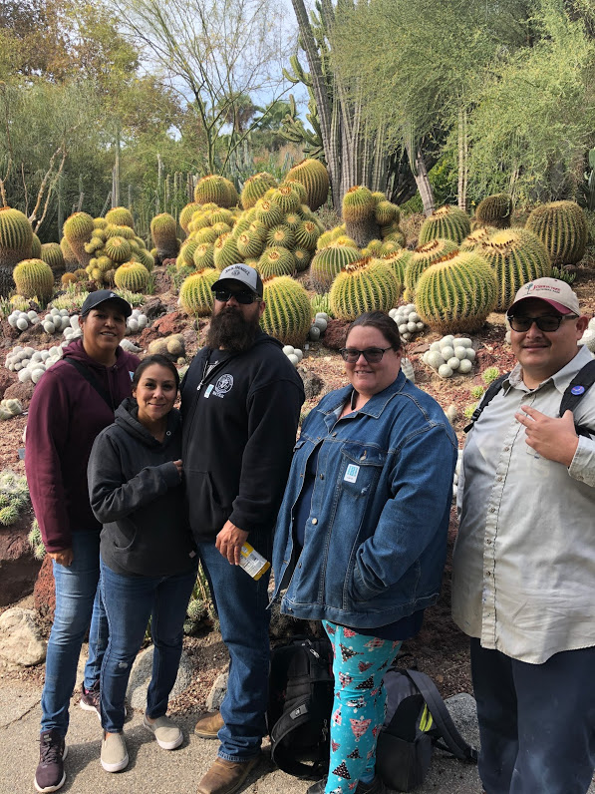
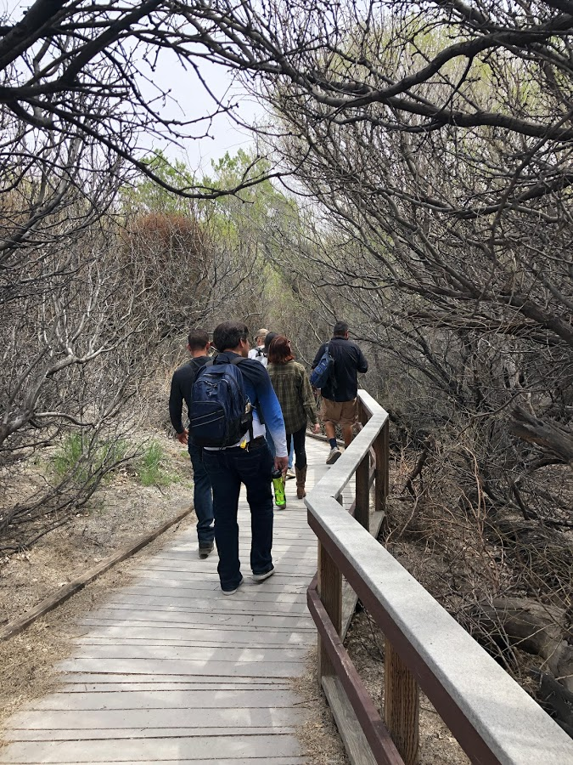
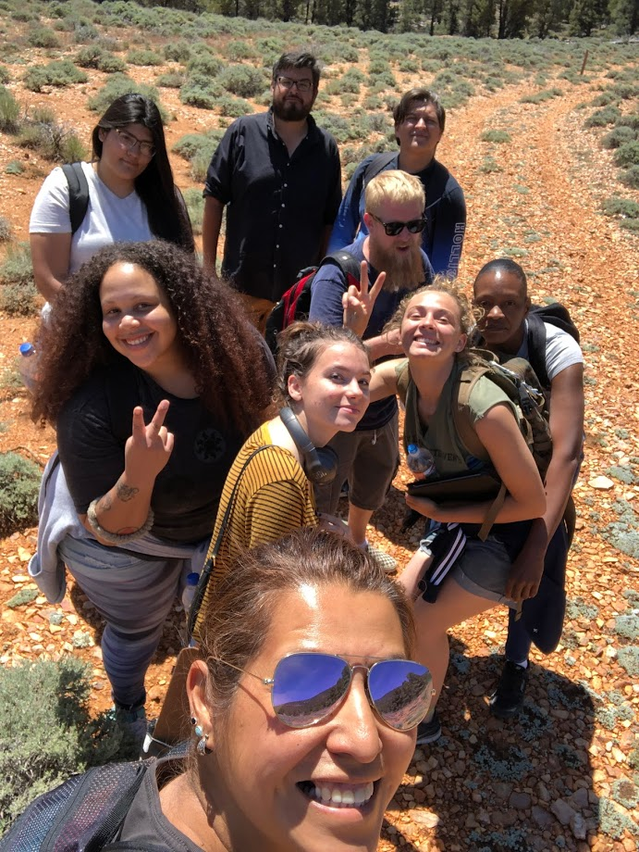
AGNR Class Field Trips

Slide 15
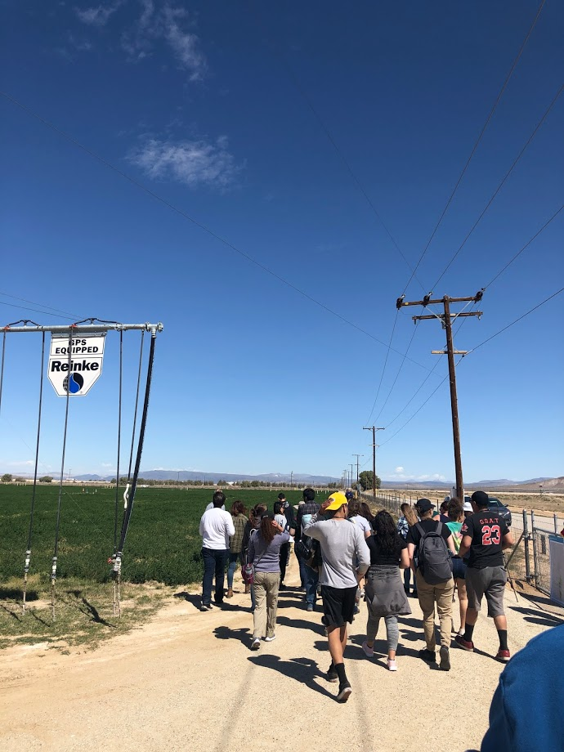
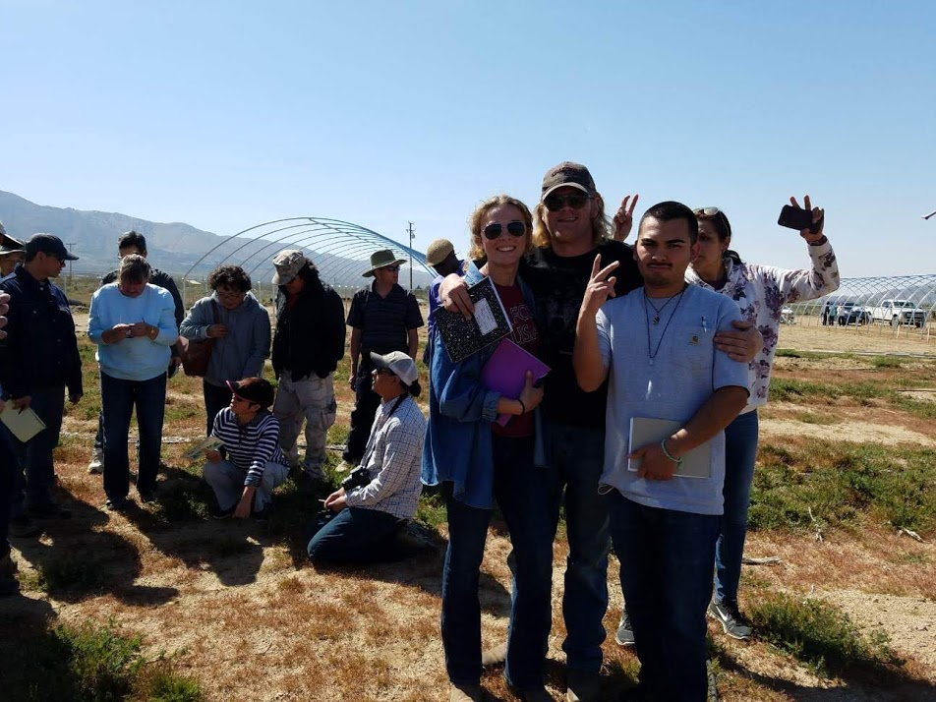
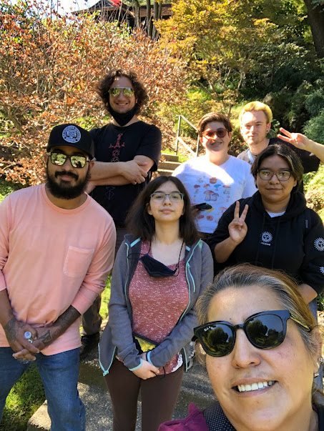

Slide 16
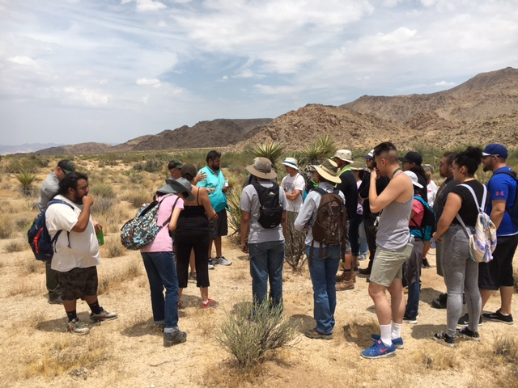
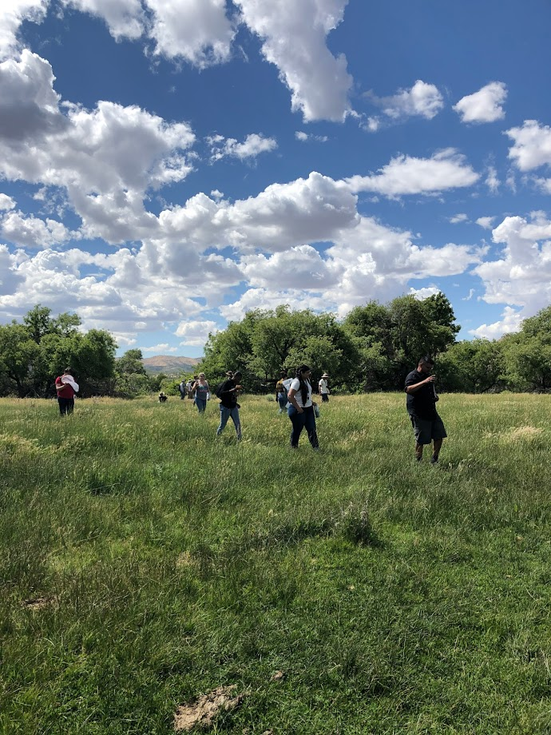
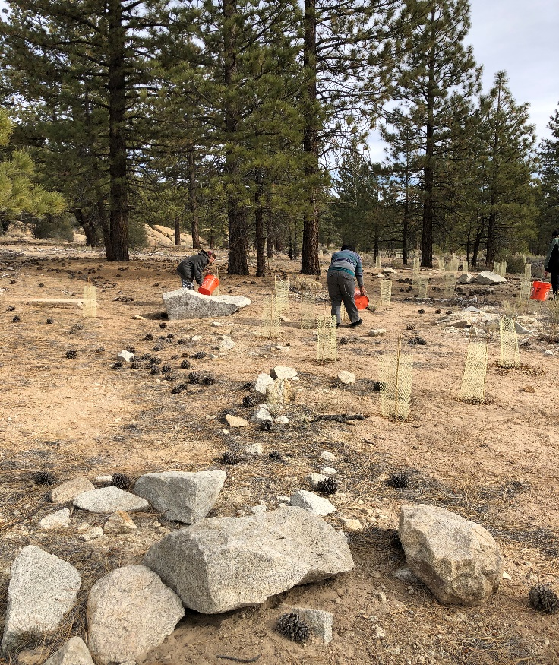

Slide 17
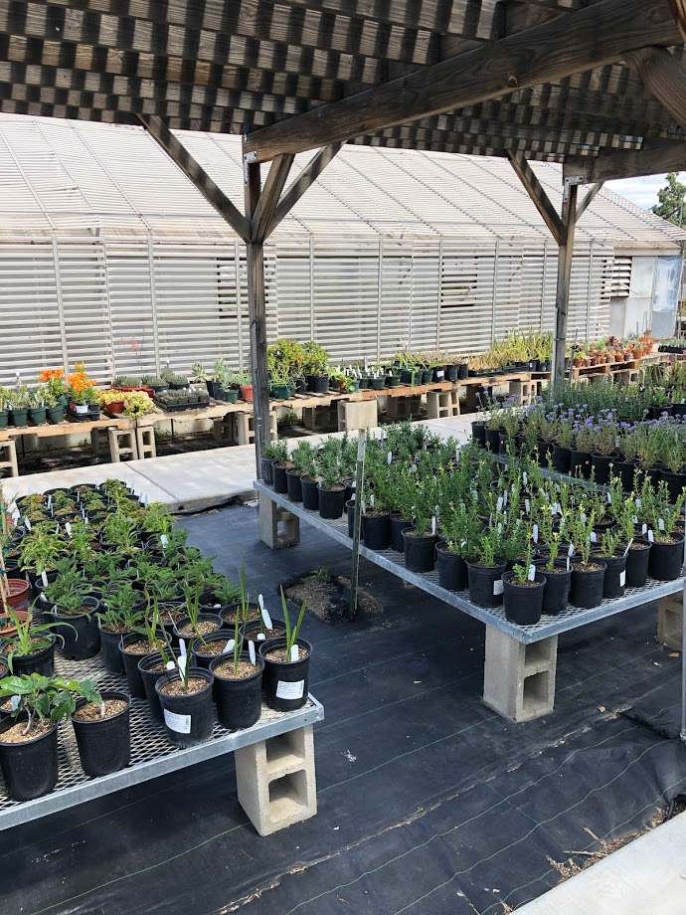
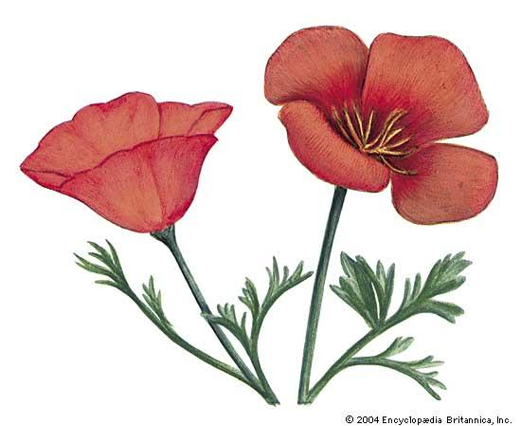
The AGNR Dept. has Two annual Plants Sales one in the Spring and one in the Fall.
Plant Sale! Information Booths by Various Local Organizations & Agencies
VVC Agriculture & Natural Resource Department Plant Sale Vegetables Landscape Plants House Plants Succulents Wildflower Seeds Various Community Informational Booths DATES: April for Spring and in October for Fall. While supplies last.
HOURS: 9A.M. –2 P.M. | Victor Valley College Lower Campus Parking Lot W 18422 Bear Valley Rd. | Victorville CA. 92395 Look for the Signs - While supplies last
Our department also has an Ongoing Environmental Horticulture Club
Club Field Trips
Club Projects
Club meetings
Club Fundraisers

Slide 18
VVC Agriculture and Natural Resources Department Contacts
Department Chair Neville Slade - neville.slade@vvc.edu
Instructional Assistant / Adjunct
Dolores Gault -
dolores.gault@vvc.edu

